Slide 1
Disassembly Manual

Slide 2
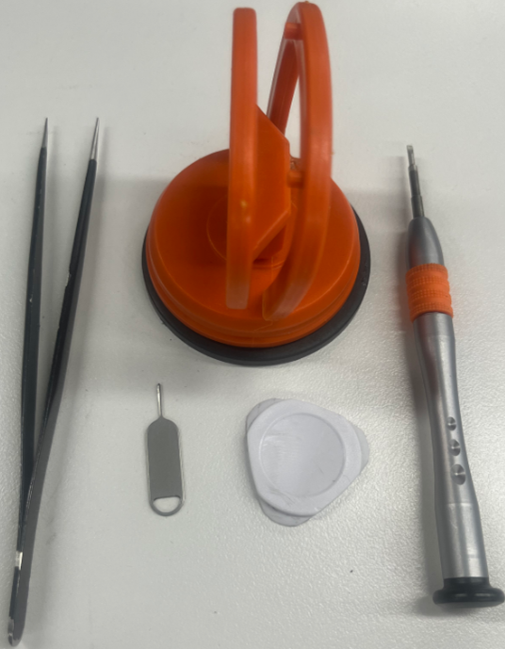
Disassembly Tools
Tweezers
Suction cup
SIM eject pin
Disassemble machine piece
Cross screwdriver –
model no:LA61322P2+PH00

Slide 3
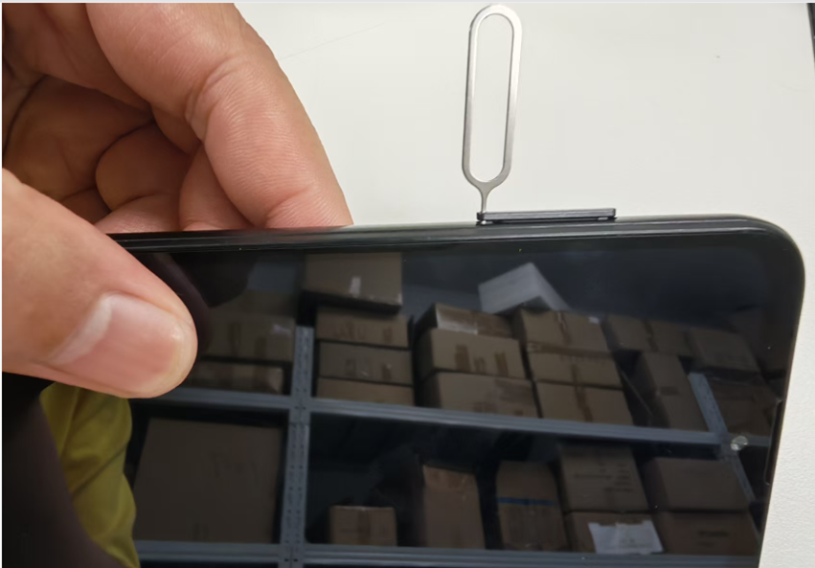
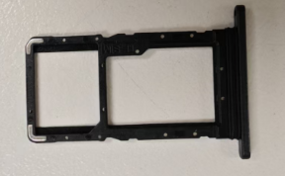
STEP 1
Use a card retrieval needle to remove the SIM tray and memory tray.

Slide 4
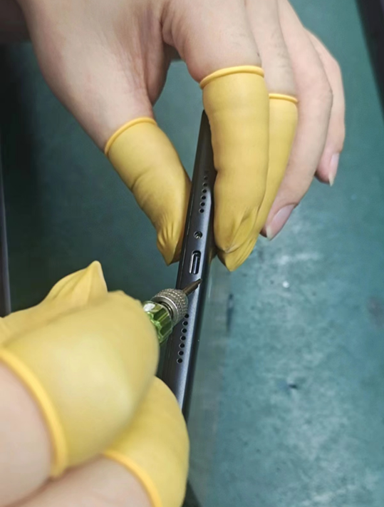
STEP 2
Remove the bottom screw* 2 pcs.

Slide 5
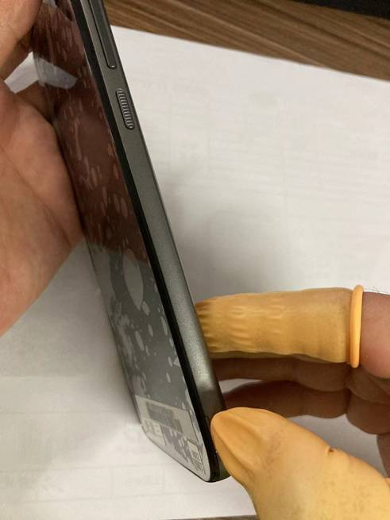
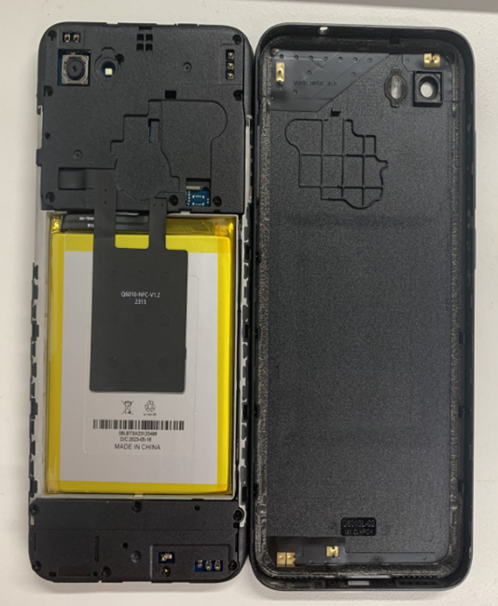
STEP 3
In this incision direction, first use the dismantling machine piece in the corner to insert the top open a little, and then use the dismantling machine to cut open the surrounding buckle, open the back cover.

Slide 6
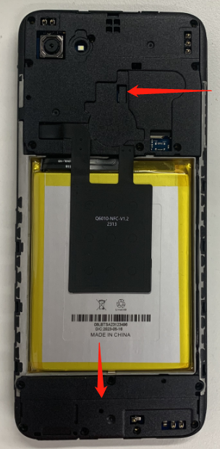
STEP 4
Remove the motherboard bracket and the horn assembly screws.

Slide 7
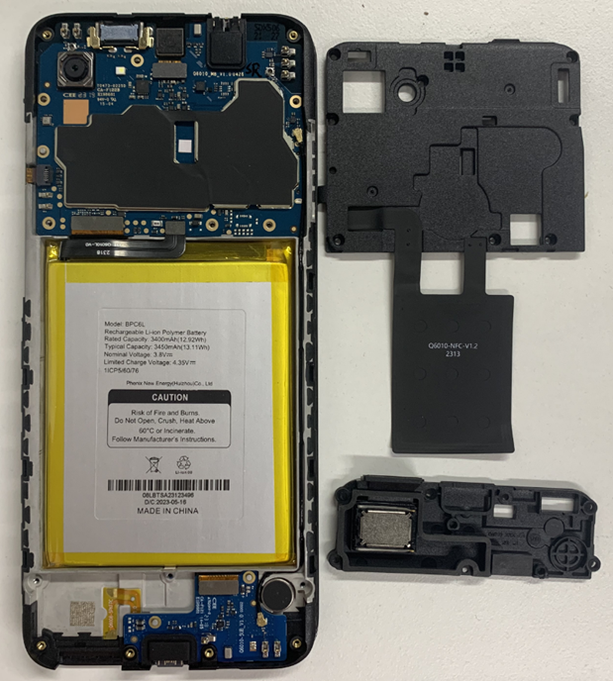
STEP 5
Remove the main board bracket/ speaker assembly/ single speaker.
Speaker

Slide 8
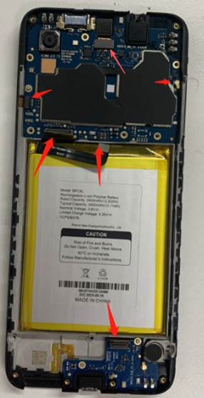
STEP 6
Disconnect the side key FPC connector \ three-in-one FPC connector \ battery FPC connector, coaxial seat, front camera FPC connector(The front camera can be removed).
the front camera FPC connector
coaxial seat
Side key FPC connector
battery FPC connector
Three in one FPC connector
Three in one FPC connector
Main Mic: Welded on the sub-board, unable to be further disassembled.

Slide 9
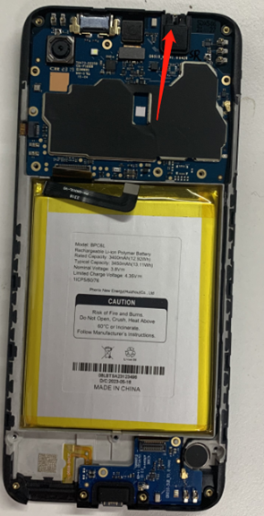
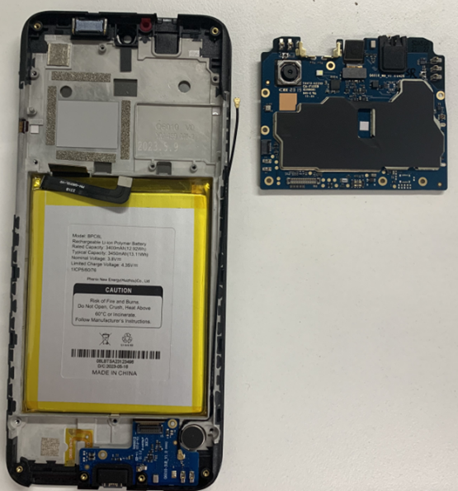
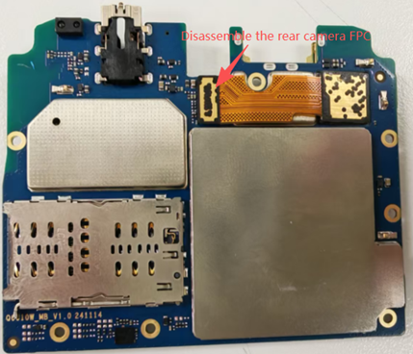
STEP 7
External audio connectors:
Welded on the sub-board, unable to be further disassembled.
Disassemble the rear camera FPC
Remove the motherboard from the headset seat

Slide 10
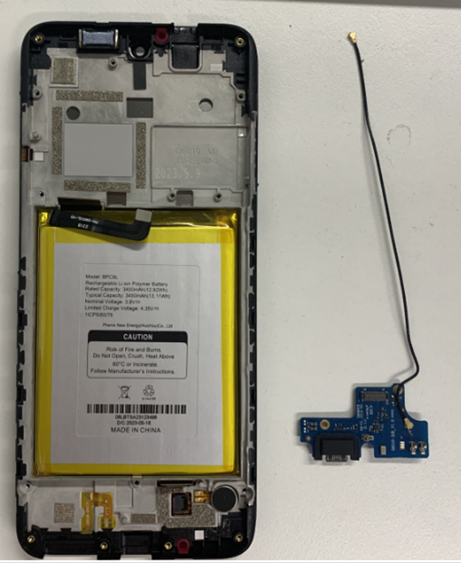
STEP 8
Remove SUB-board and coaxis.
External charging port: Welded on the sub-board, unable to be further disassembled.

Slide 11
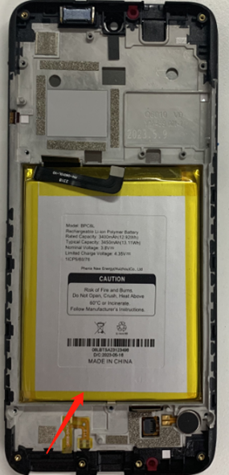
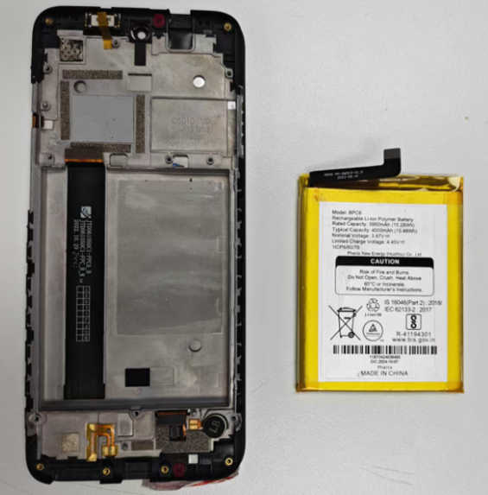
STEP 9
Put the three-in-one module in the refrigerator for 20-30 minutes, then take out and knock out the battery.

Slide 12
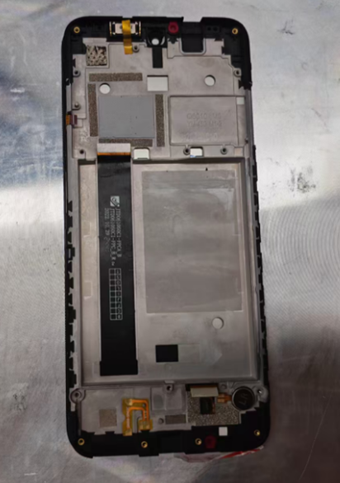
STEP 10
Place the whole unit face down on the heating plate and heat at 75°C for 5–8 minutes

Slide 13
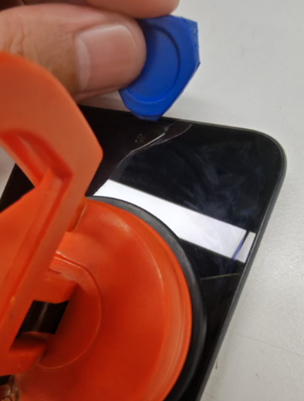
STEP 11
First, use a suction cup to grip the display and pull gently to create a small gap. Then insert an opening pick to pry it open slightly. Next, slide the opening pick around the edges to separate the adhesive. Finally, remove the TP.

Slide 14
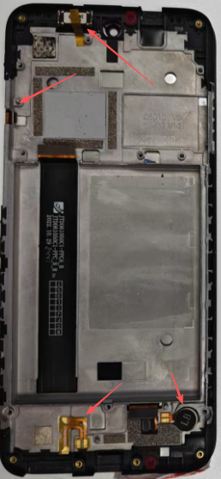
STEP 12
Remove earpiece, side key (Mechanical buttons), vibration motor, speaker FPC.
side key
earpiece
speaker FPC
vibration motor

Slide 15
Assembly Manual

Slide 16
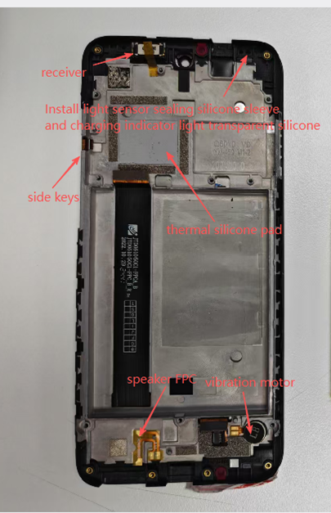
Install receiver, side keys, thermal silicone, speaker FPC, and vibration motor.
Install light sensor sealing silicone sleeve and charging indicator light transparent silicone

Slide 17
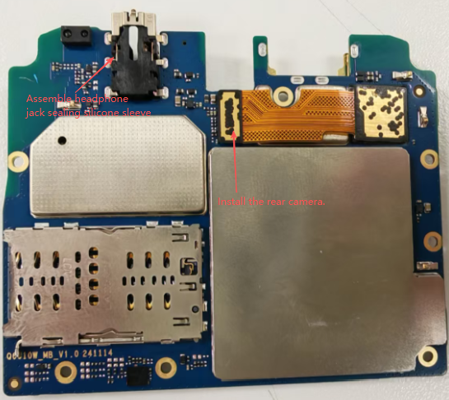
STEP 1
Assemble headphone jack sealing silicone sleeve and rear camera.

Slide 18
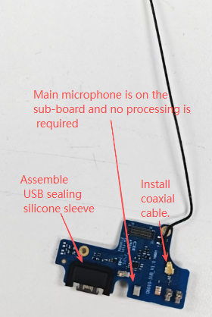
STEP 2
Assemble USB sealing silicone sleeve and install coaxial cable.

Slide 19
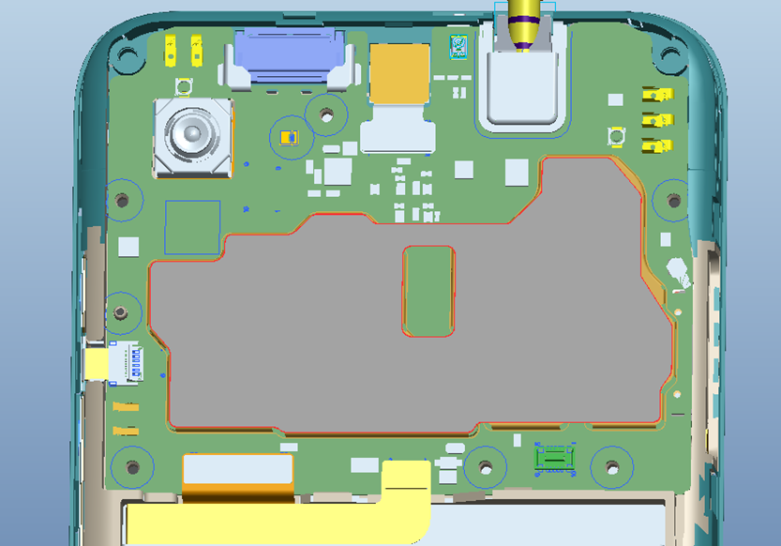
STEP 3
Attach shielding cover thermal graphite sheet

Slide 20
STEP 4
Connect the side key FPC connector, three-in-one FPC connector, battery FPC connector, coaxial seat and front camera FPC connector
the front camera FPC connector
coaxial seat
Side key FPC connector
battery FPC connector
Three in one FPC connector
Three in one FPC connector

Slide 21
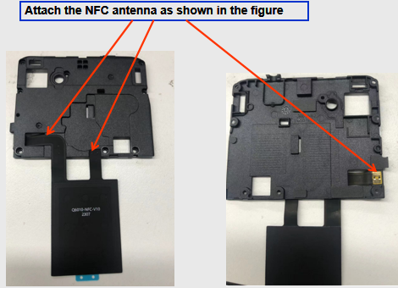
STEP 5
Attach the NFC antenna as shown in the figure

Slide 22
STEP 6
Install the mainboard bracket and speaker assembly (single speaker).
Speaker

Slide 23
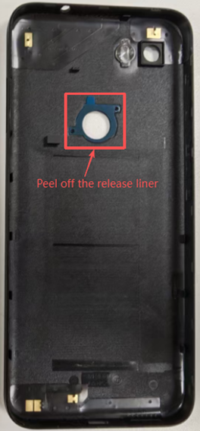
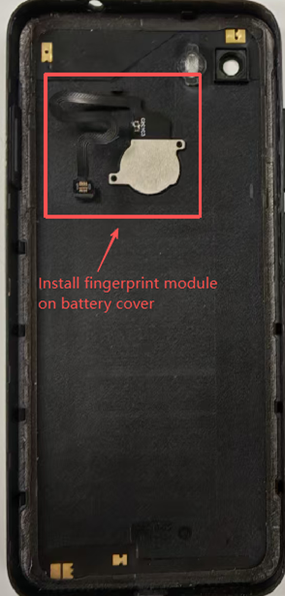
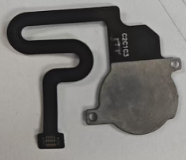
Peel off the release liner and fit the fingerprint module onto the battery cover

Slide 24
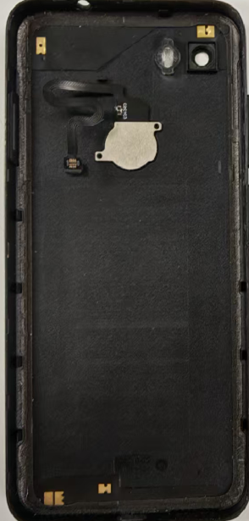
STEP 7
Install the mainboard bracket and speaker assembly screws, engage the fingerprint module connector, then fit the battery cover.
Snap on the fingerprint module connector

Slide 25
STEP 8
Remove the bottom screw* 2 pcs

